Slide 1
IBCS
OOP: Object-oriented programming
Wu Di
武迪
Sept, 2016
Notes:
Helpful to include code examples to support your answer.
If you do write the code, the accuracy of syntax will not be marked, only the logic

Slide 2
OUTLINE
Characteristics of programming paradigms
Types of high-level language
Parameters and local and global variables
Structured program development
Calling procedures and passing parameters via a stack

Slide 3
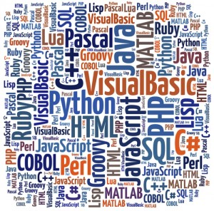
Characteristics of programming paradigms
Programming paradigm:
a way/method of programming
a special technical term
Syllabus requirement:
“Describe the characteristics of a variety of programming paradigms”
https://en.wikipedia.org/wiki/List_of_programming_languages_by_type
Notes:
http://xrds.acm.org/resources/how-to-learn-programming-languages.cfm

Slide 4
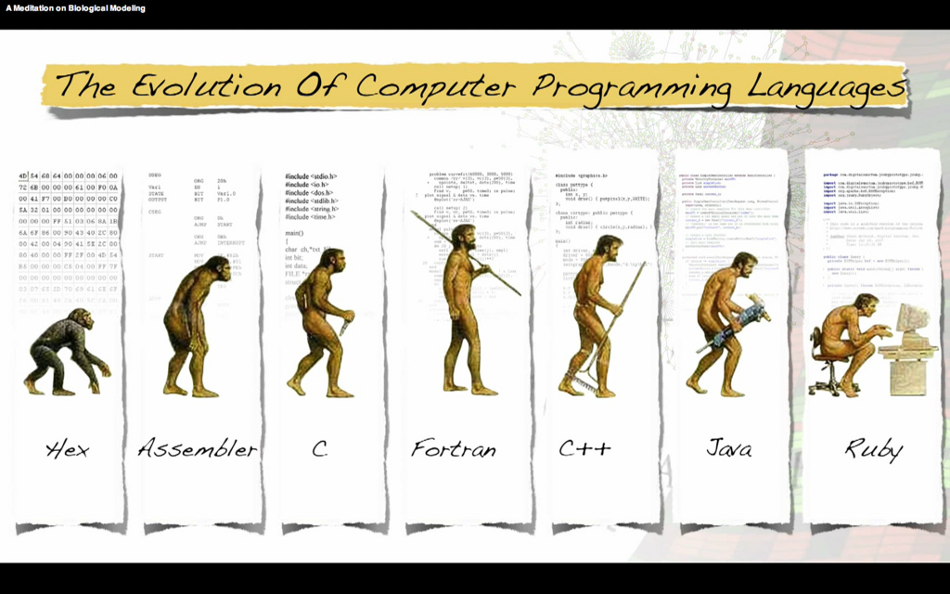
Characteristics of programming paradigms
Notes:
http://xrds.acm.org/resources/how-to-learn-programming-languages.cfm

Slide 5
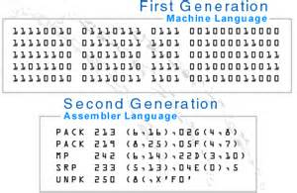
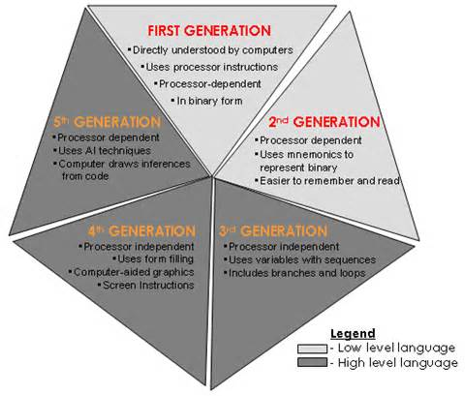
Characteristics of programming paradigms
Low-level paradigm: machine code
Machine code (1 GL):
Difficult to write and lead to many errors in program code that were difficult to find
Communicate in binary
Notes:
http://xrds.acm.org/resources/how-to-learn-programming-languages.cfm

Slide 6
Characteristics of programming paradigms
Low-level paradigm: assembly language
Assembly languages(2 GL):
Replace machine code operations with mnemonics
Allow labels for memory address
Improvement over machine code
Still prone to errors and code still difficult to debug, correct and maintain
Notes:
http://xrds.acm.org/resources/how-to-learn-programming-languages.cfm

Slide 7
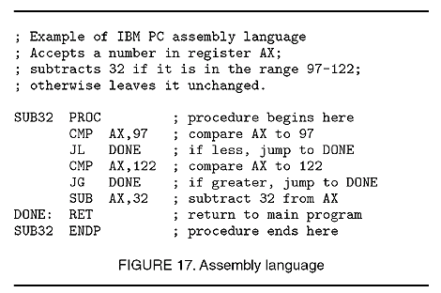
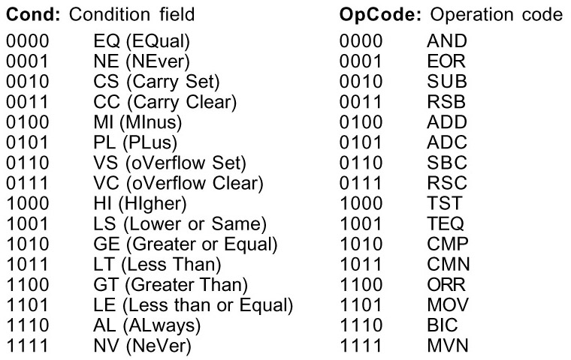
Characteristics of programming paradigms
Assembly languages(2 GL):
Replace machine code operations with mnemonics
Allow labels for memory address
Improvement over machine code
Still prone to errors and code still difficult to debug, correct and maintain
Low-level paradigm: assembly language
Notes:
http://xrds.acm.org/resources/how-to-learn-programming-languages.cfm

Slide 8
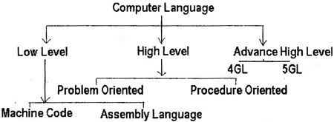
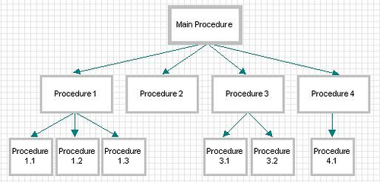
Characteristics of programming paradigms
Procedural paradigm
Third-generation programming language
Or High level programming language
Notes:
http://itecdigital.org.uk/softwaredev/417880/softwaredevyear1/units/unit_1/html/paradigms.html

Slide 9
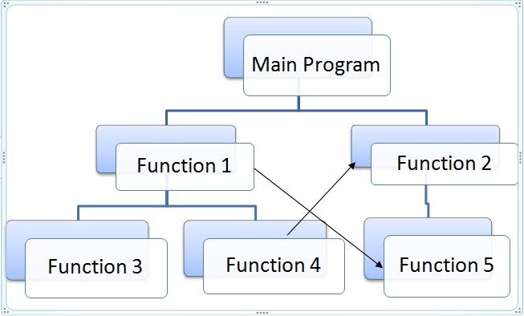
Characteristics of programming paradigms
Procedural paradigm
Third-generation programming language
Or High level programming language
The word “procedure” is the key element here to notice. It means “a set of procedures” which is a “set of subroutines” or a “set of functions“.
In a POP method, emphasis is given to functions or subroutines. Functions are a set of instructions which performs a particular task. Functions are called repeatedly in a program to execute tasks performed by them. For example, a program may involve collecting data from user (reading), performing some kind of calculations on the collected data (calculation), and finally displaying the result to the user when requested (printing). All the 3 tasks of reading, calculating and printing can be written in a program with the help of 3 different functions which performs these 3 different tasks.
Notes:
In a POP method, emphasis is given to functions or subroutines. Functions are a set of instructions which performs a particular task. Functions are called repeatedly in a program to execute tasks performed by them. For example, a program may involve collecting data from user (reading), performing some kind of calculations on the collected data (calculation), and finally displaying the result to the user when requested (printing). All the 3 tasks of reading, calculating and printing can be written in a program with the help of 3 different functions which performs these 3 different tasks.

Slide 10
Characteristics of programming paradigms
Procedural paradigm
Third-generation programming language
Or High level programming language
The word “procedure” is the key element here to notice. It means “a set of procedures” which is a “set of subroutines” or a “set of functions“.
In POP method, a problem is viewed as a sequence of tasks to be implemented like reading, performing calculations, displaying results etc. All the tasks are analysed first and later functions/procedures are developed to implement all these tasks in a program.
Notes:
In a POP method, emphasis is given to functions or subroutines. Functions are a set of instructions which performs a particular task. Functions are called repeatedly in a program to execute tasks performed by them. For example, a program may involve collecting data from user (reading), performing some kind of calculations on the collected data (calculation), and finally displaying the result to the user when requested (printing). All the 3 tasks of reading, calculating and printing can be written in a program with the help of 3 different functions which performs these 3 different tasks.

Slide 11
Characteristics of programming paradigms
Procedural paradigm
Third-generation programming language
Or High level programming language
Problem-oriented: they use a language and syntax appropriate to the type of problem being solved.
FORTRAN (FORmula Translation)
ALGOL(ALGOrithmic Language)
BASIC (Beginners All purpose Symbolic Instruction Code)
Scientific and engineering problems
Teaching
Visual Basic.Net
Sit inside the Microsoft .Net Framework and allow for development of Windows-based applications
Notes:
http://xrds.acm.org/resources/how-to-learn-programming-languages.cfm

Slide 12
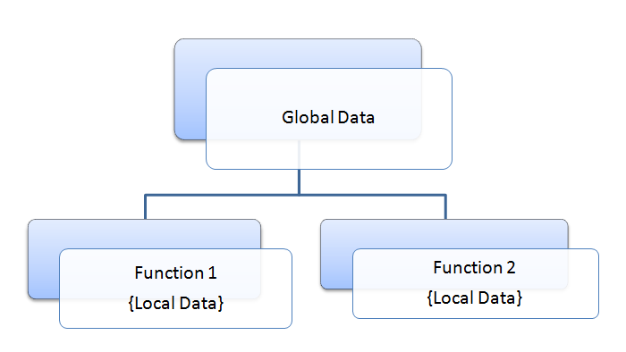
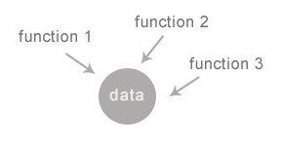
Characteristics of programming paradigms
Procedural paradigm
Third-generation programming language
Or High level programming language
Object-oriented paradigm
Problem with POP:
Handling of data: Many functions can modify a given block of data
notable drawbacks in creating reusable software components:
separate the data structures and algorithms/function
Notes:
Can we do this in traditional procedural-oriented programming language such as C, Fortran, Cobol, or Pascal?
Traditional procedural-oriented languages (such as C and Pascal) suffer some notable drawbacks in creating reusable software components:
The programs are made up of functions. Functions are often not reusable. It is very difficult to copy a function from one program and reuse in another program because the the function is likely to reference the headers, global variables and other functions. In other words, functions are not well-encapsulated as a self-contained reusable unit.
The procedural languages are not suitable of high-level abstraction for solving real life problems. For example, C programs uses constructs such as if-else, for-loop, array, function, pointer, which are low-level and hard to abstract real problems such as a Customer Relationship Management (CRM) system or a computer soccer game. (Imagine using assembly codes, which is a very low level code, to write a computer soccer game. C is better but no much better.)
In brief, the traditional procedural-languages separate the data structures and algorithms of the software entities.

Slide 13
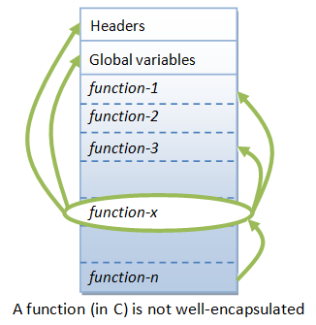
Characteristics of programming paradigms
Procedural paradigm
Third-generation programming language
Or High level programming language
Object-oriented paradigm
Problem with POP:
Handling of data: Many functions can modify a given block of data
notable drawbacks in creating reusable software components:
separate the data structures and algorithms/function
Notes:
Can we do this in traditional procedural-oriented programming language such as C, Fortran, Cobol, or Pascal?
Traditional procedural-oriented languages (such as C and Pascal) suffer some notable drawbacks in creating reusable software components:
The programs are made up of functions. Functions are often not reusable. It is very difficult to copy a function from one program and reuse in another program because the the function is likely to reference the headers, global variables and other functions. In other words, functions are not well-encapsulated as a self-contained reusable unit.
The procedural languages are not suitable of high-level abstraction for solving real life problems. For example, C programs uses constructs such as if-else, for-loop, array, function, pointer, which are low-level and hard to abstract real problems such as a Customer Relationship Management (CRM) system or a computer soccer game. (Imagine using assembly codes, which is a very low level code, to write a computer soccer game. C is better but no much better.)
In brief, the traditional procedural-languages separate the data structures and algorithms of the software entities.

Slide 14
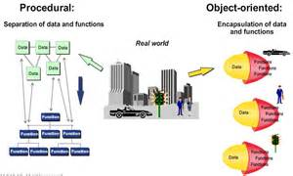
Characteristics of programming paradigms
Procedural paradigm
Third-generation programming language
Or High level programming language
Object-oriented paradigm
Notes:
Can we do this in traditional procedural-oriented programming language such as C, Fortran, Cobol, or Pascal?
Traditional procedural-oriented languages (such as C and Pascal) suffer some notable drawbacks in creating reusable software components:
The programs are made up of functions. Functions are often not reusable. It is very difficult to copy a function from one program and reuse in another program because the the function is likely to reference the headers, global variables and other functions. In other words, functions are not well-encapsulated as a self-contained reusable unit.
The procedural languages are not suitable of high-level abstraction for solving real life problems. For example, C programs uses constructs such as if-else, for-loop, array, function, pointer, which are low-level and hard to abstract real problems such as a Customer Relationship Management (CRM) system or a computer soccer game. (Imagine using assembly codes, which is a very low level code, to write a computer soccer game. C is better but no much better.)
In brief, the traditional procedural-languages separate the data structures and algorithms of the software entities.

Slide 15
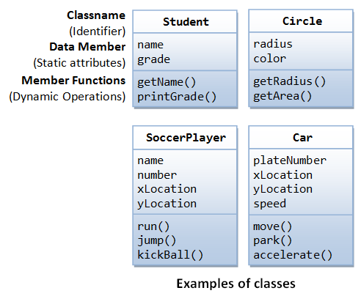
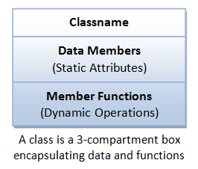
Characteristics of programming paradigms
Object-oriented paradigm
Third-generation programming language
Or High level programming language
https://www3.ntu.edu.sg/home/ehchua/programming/cpp/cp3_OOP.html
http://evinw.com/oop/
Notes:
http://notthecheatr.phatcode.net/articles/whyOOP.html
http://www.felixgers.de/teaching/oop/oop_intro.html

Slide 16
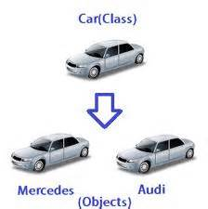
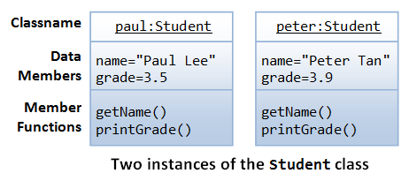
Characteristics of programming paradigms
Object-oriented paradigm
Third-generation programming language
Or High level programming language
http://evinw.com/oop/
Notes:
http://notthecheatr.phatcode.net/articles/whyOOP.html
http://www.felixgers.de/teaching/oop/oop_intro.html

Slide 17
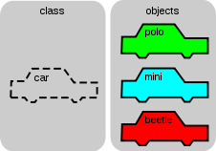
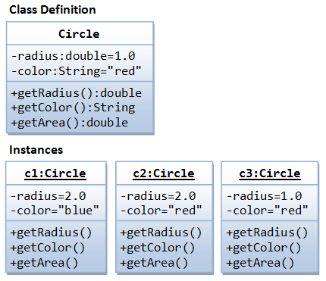
Characteristics of programming paradigms
Object-oriented paradigm
Third-generation programming language
Or High level programming language
Notes:
http://notthecheatr.phatcode.net/articles/whyOOP.html
http://www.felixgers.de/teaching/oop/oop_intro.html

Slide 18
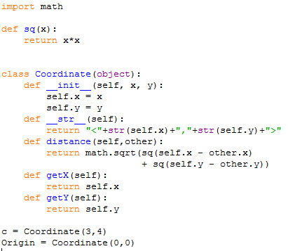
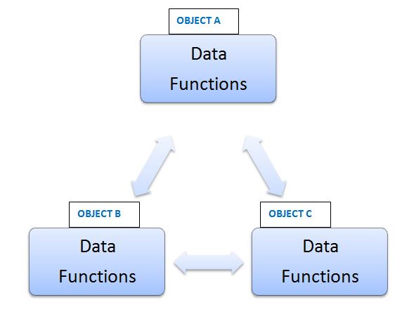
Characteristics of programming paradigms
Object-oriented paradigm
Third-generation programming language
Or High level programming language
Notes:
http://notthecheatr.phatcode.net/articles/whyOOP.html
http://www.felixgers.de/teaching/oop/oop_intro.html

Slide 19
Characteristics of programming paradigms
Object-oriented paradigm
Third-generation programming language
Or High level programming language
Object: data and methods of manipulating the data are designed and coded as a single unit
Object’s Method: the only way that a user can access the data is via the Object’s Method
Code security
Hiding details
easy to modify
Notes:
http://notthecheatr.phatcode.net/articles/whyOOP.html
http://www.felixgers.de/teaching/oop/oop_intro.html

Slide 20
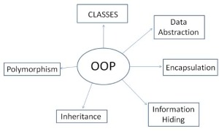
Characteristics of programming paradigms
Object-oriented paradigm
Third-generation programming language
Or High level programming language
Notes:
http://notthecheatr.phatcode.net/articles/whyOOP.html
http://www.felixgers.de/teaching/oop/oop_intro.html

Slide 21
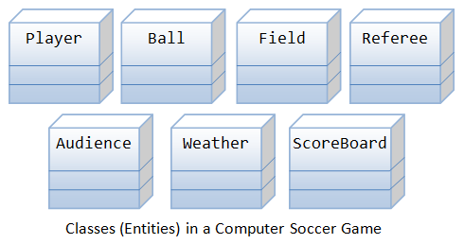
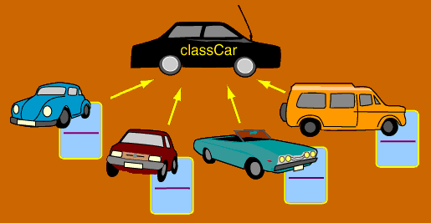
Types of high-level language
OOP
Object-oriented programming languages
The real world consists of objects, not program

Slide 22
Types of high-level language
OOP
Object-oriented programming languages
Class: blueprint or definition of some type of object
Object: an actual instance of the class
Can use data structures like array.
Demo
Python supports many different kinds of data:
Notes:
Class: object type
Object: specific data of the class type

Slide 23
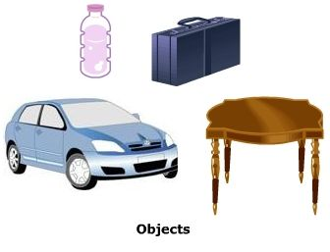
Object-oriented programming
What is an Object?
Objects are Real-World Entities of OOP.
A group of features can represent an Object.
If anything is in Real World then that will be an Object.
An Object can be Visible, Ideological or analytical.
Variables are used to store an Objects Identity and State and Methods are used to show it's behavior.
Examples of an Object are Pen, People, Table etc.
Notes:
http://www.c-sharpcorner.com/UploadFile/d0a1c8/object-oriented-programming-in-C-Sharp-net/

Slide 24
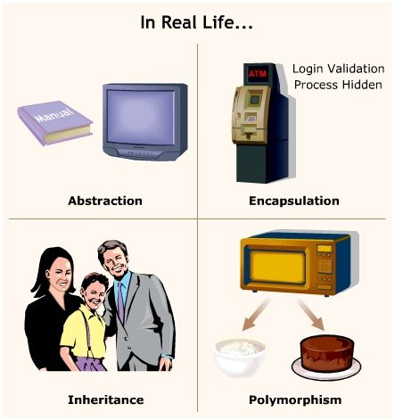
Object-oriented programming
The features of OOP are:
Objects
Classes
Data Abstraction and Encapsulation
Inheritance
Polymorphism
Dynamic Binding
Notes:
http://www.c-sharpcorner.com/UploadFile/d0a1c8/object-oriented-programming-in-C-Sharp-net/
http://evinw.com/oop/

Slide 25
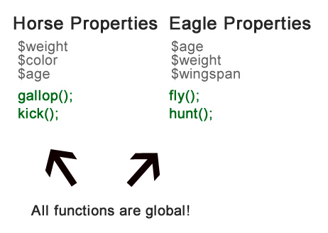
Object-oriented programming
Biggest problems with POP:
data security
Code reuse
The interpreter when ran has no clue that eagles can not gallop or that horses can not fly. If there is an illegal call it has to handle it at run time and that can lead to major problems. In this example we can see how all functions and properties are global and they belong to nothing.
Notes:
The interpreter when ran has no clue that eagles can not gallop or that horses can not fly. If there is an illegal call it has to handle it at run time and that can lead to major problems. In this example we can see how all functions and properties are global and they belong to nothing.

Slide 26
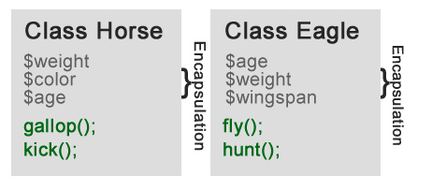
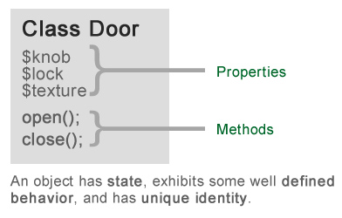
Object-oriented programming
Now with this information the interpreter know that said methods and properties belong to a class. A class is defined as a state(properties i.e. variables) and behaviour(methods i.e. functions).
A class represents a set of objects that share common structure and a common behaviour.
Encapsulation
Data encapsulation: data can only be accessed via the methods provided by the class
Notes:
http://www.c-sharpcorner.com/UploadFile/d0a1c8/object-oriented-programming-in-C-Sharp-net/

Slide 27
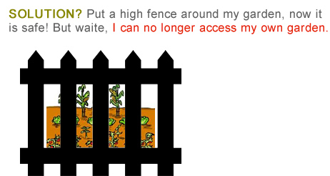
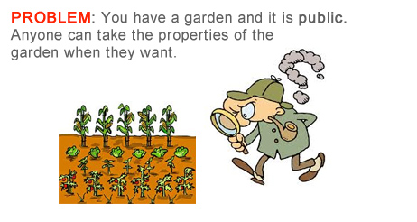
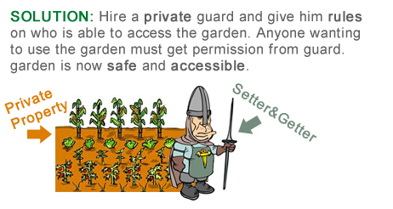
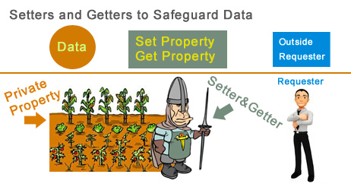
Object-oriented programming
a
b
c
d
Notes:
http://www.c-sharpcorner.com/UploadFile/d0a1c8/object-oriented-programming-in-C-Sharp-net/

Slide 28
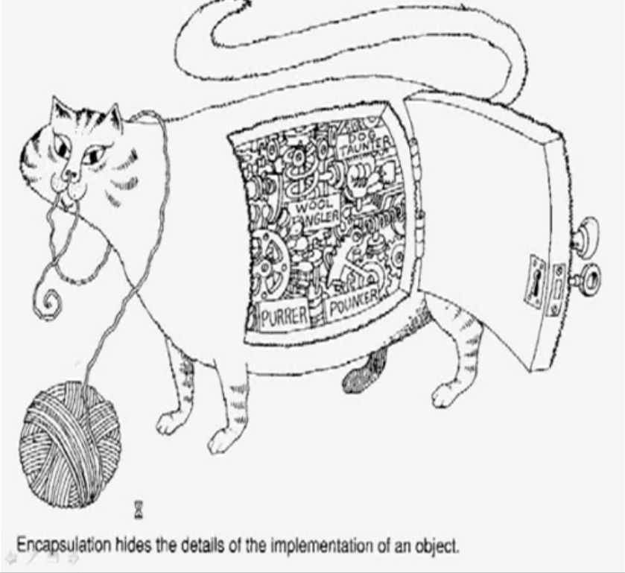
Object-oriented programming

Slide 29
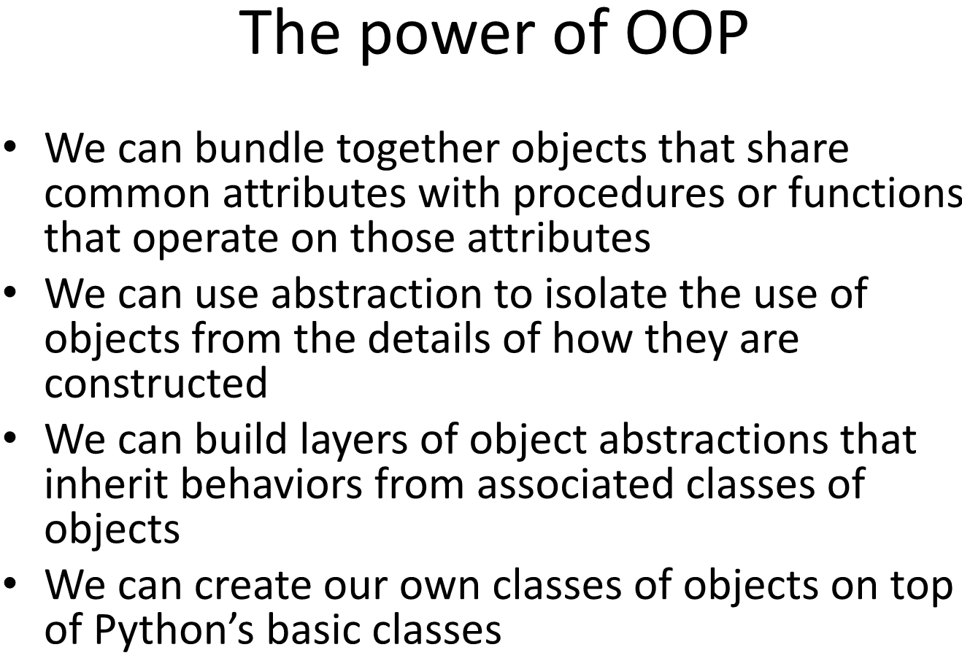
Object-oriented programming
Notes:
Lecture 11

Slide 30
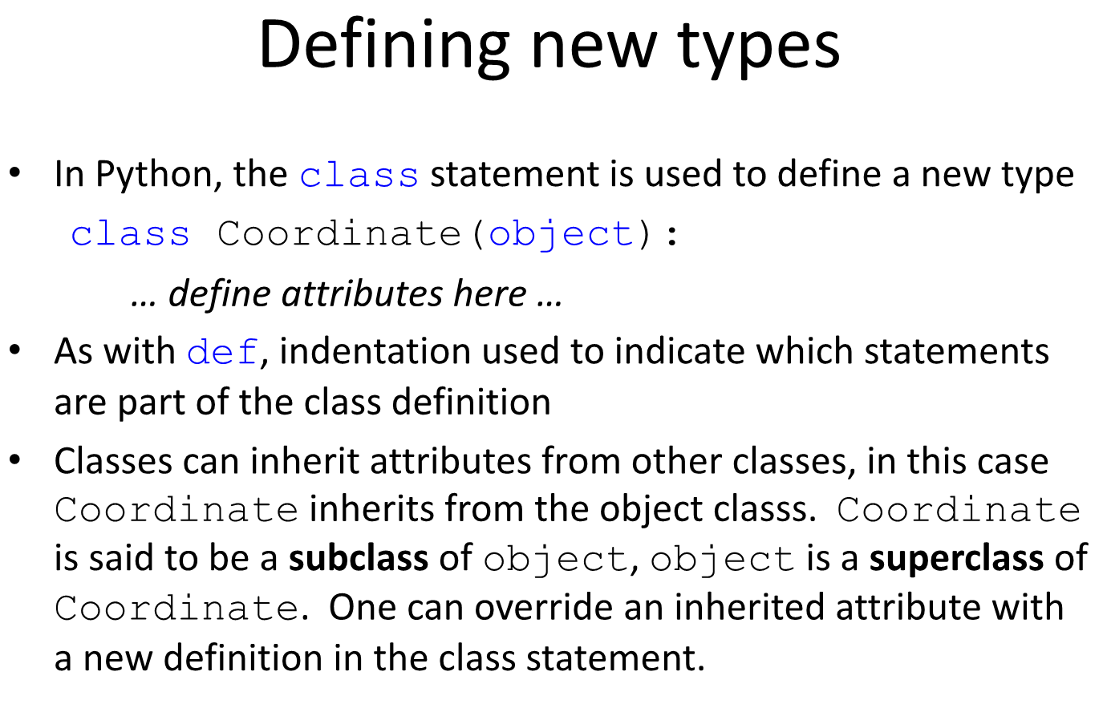
Object-oriented programming

Slide 31
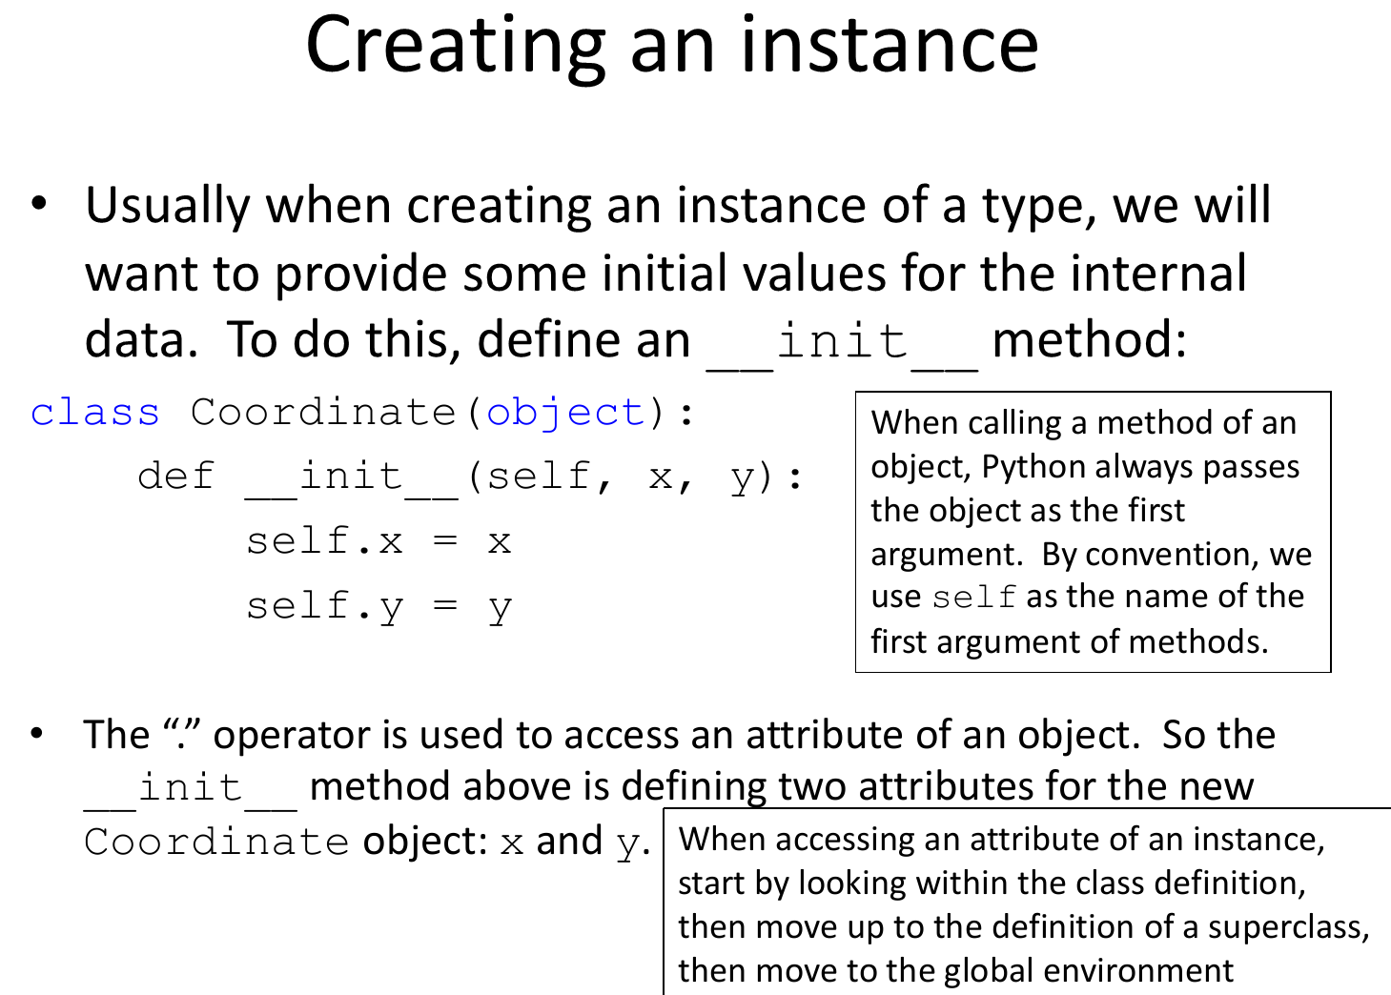
Object-oriented programming
Dot notation

Slide 32
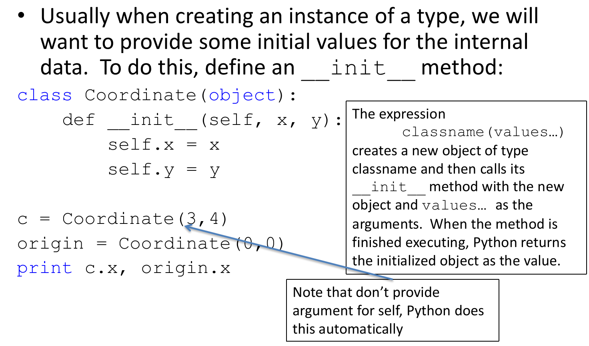
Object-oriented programming
Setter function
Getter function
Python can access properties data, but are not encouraged
Java require get and set method for interface!!!

Slide 33
Object-oriented programming
Dot notation
Denote the use of the object’s method, e.g. Origin.getY()
Setter function
Getter function
print c.getX()
print c.getY()

Slide 34
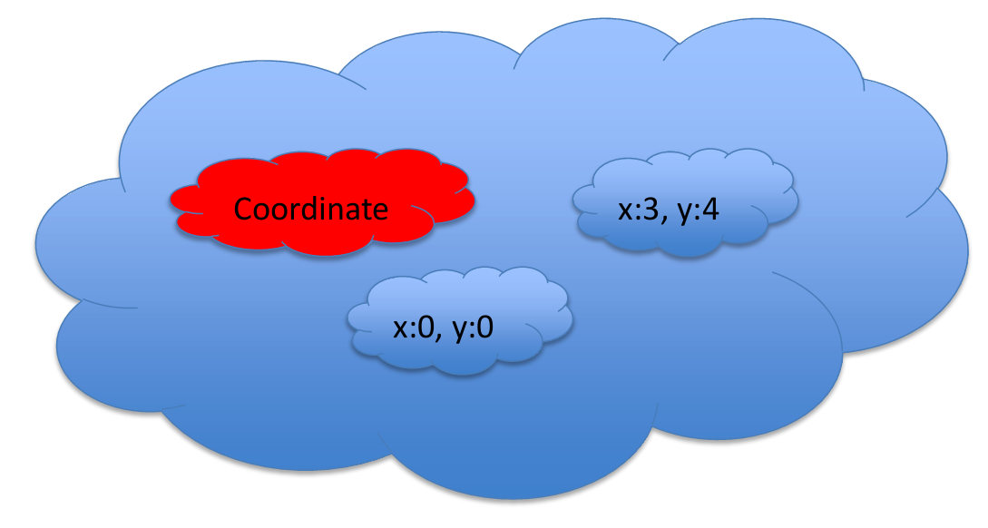
Object-oriented programming
The concept of data being accessible only by means of the methods provided is very important as it ensures data integrity
Once a class has been designed, written and fully tested, neither its methods nor the data value of its properties can be tempered with.
If the original design of a method is found to be inefficient, the design can be changed without the user’s program being affected!
Encapsulation

Slide 35
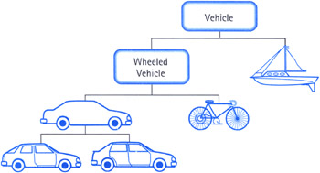
Object-oriented programming
Inheritance and class diagrams
Inheritance allows one class – called a child class – to inherit (i.e. use) all the properties and methods of its parent class
Notes:
http://younginc.site11.com/source/5895/fos0019.html

Slide 36
Object-oriented programming
Inheritance and class diagrams
Inheritance allows one class – called a child class – to inherit (i.e. use) all the properties and methods of its parent class
Person
Class identifier
name
address
Properties
outputData()
getName()
getAddress()
Methods

Slide 37
Object-oriented programming
Inheritance and class diagrams
Inheritance allows one class – called a child class – to inherit (i.e. use) all the properties and methods of its parent class
Person
Parent class or
super-class
name
address
outputData()
getName()
getAddress()
Employee
Child class or derived class or subclass
HINumber
outputData ()
getHINumber ()

Slide 38
Object-oriented programming
Person
Parent class or
super-class
name
address
outputData()
getName()
getAddress()
Employee
Child class or derived class or subclass
HINumber
outputData ()
getHINumber ()
HourlyPaidEmp
SalariedEmp
hourlyRate
salary
outputData ()
outputData ()
getSalary ()

Slide 39
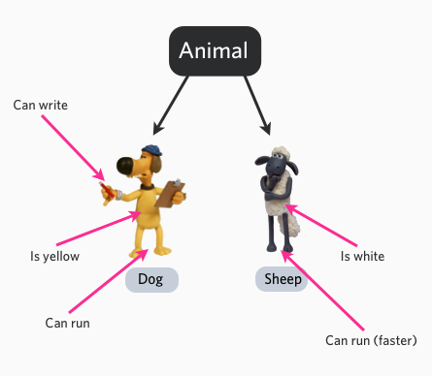
Object-oriented programming
Inheritance and class diagrams
Notes:
http://www.codercaste.com/2011/01/12/what-is-object-oriented-programming-and-why-you-need-to-use-it/

Slide 40
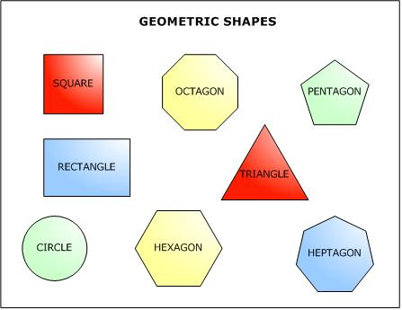
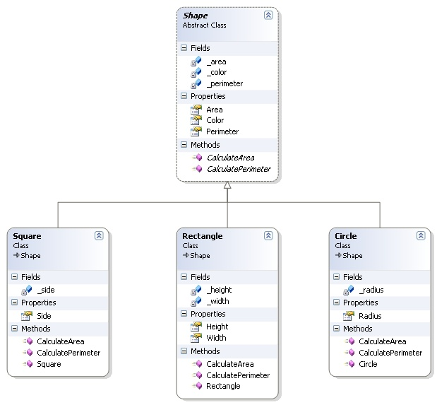
Object-oriented programming
Inheritance and class diagrams
Notes:
http://www.dotnettreats.com/tipstricks/oopconcepts2.aspx

Slide 41
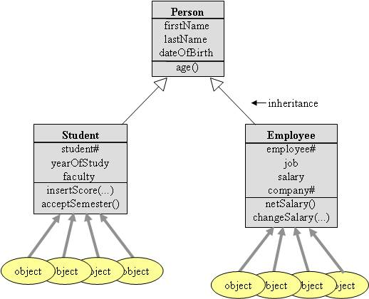
Object-oriented programming
Inheritance and class diagrams

Slide 42
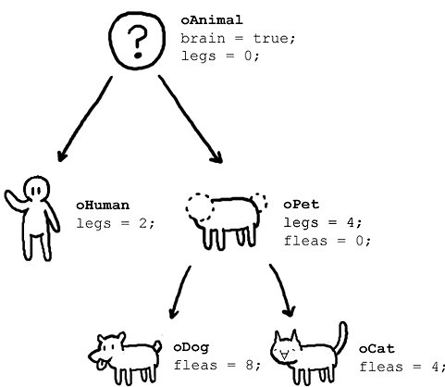
Object-oriented programming
Inheritance and class diagrams

Slide 43
Object-oriented programming
Object diagram
Classes: groups of real things. If there is a class called Student, it presupposes that there are some students that it represents.
Each individual student has specific data stored for each of the properties. A specific student is an object of this class.

Slide 44
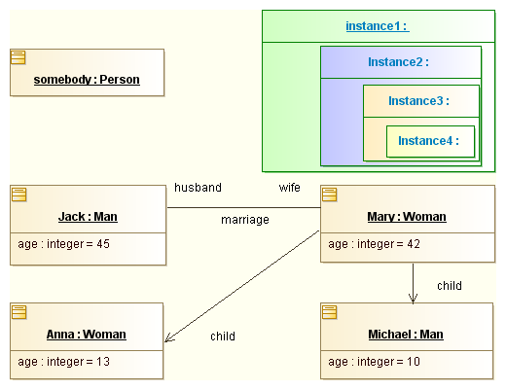
Object-oriented programming
Object diagram
Classes: groups of real things. If there is a class called Student, it presupposes that there are some students that it represents.
Each individual student has specific data stored for each of the properties. A specific student is an object of this class.

Slide 45
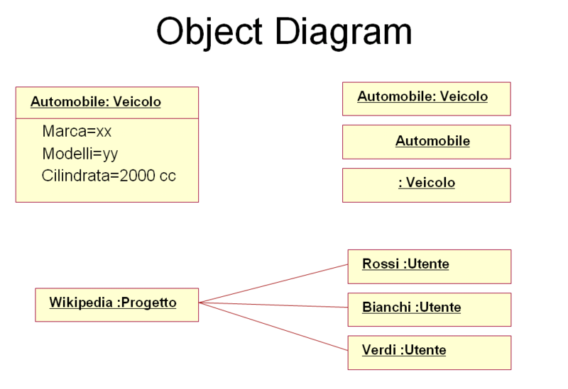
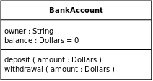
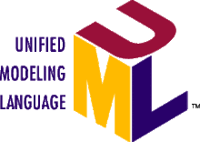
Object-oriented programming
Object diagram
UML: The Unified Modeling Language (UML) is a general-purpose modeling language in the field of software engineering, which is designed to provide a standard way to visualize the design of a system
Class diagram
https://en.wikipedia.org/wiki/Unified_Modeling_Language

Slide 46
Object-oriented programming
Definitions
State the meaning of the term
A class describe the properties and methods of some real-world entity. The class definition is the “blueprint” from actual objects are later created.
An object is an instance of a class, i.e. a real-world entity
Data encapsulation is the combining of the properties and methods for an object. Assigning and retrieving an object’s property values are only done using methods to access the data.
Inheritance is the ability of a class (the derived class) to use the properties and methods of another class (the parent class)

Slide 47
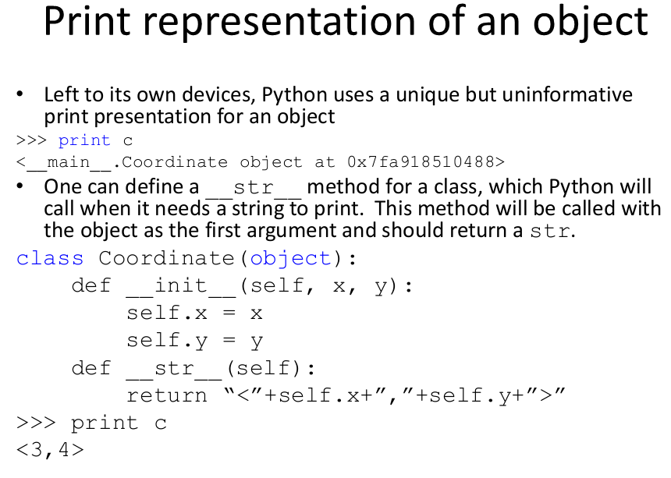
Object-oriented programming

Slide 48

Object-oriented programming

Slide 49

Object-oriented programming

Slide 50

Object-oriented programming

Slide 51

Object-oriented programming

Slide 52

Object-oriented programming

Slide 53

Object-oriented programming

Slide 54
Object-oriented programming
Lecture 12 OOP and inheritance
Lecture notes, code and video
Activity
YOU AND YOUR COMPUTER:
A word Game
Summarize OOP
L12 PROBLEM 3,4
https://courses.edx.org/courses/course-v1:MITx+6.00.1x_6+2T2015/courseware/Week_6/videosequence:Lecture_11/

